Slide 1
EIGHT YEARS OF PAID FAMILY LEAVE: WHAT EMPLOYERS CAN LEARN FROM THE CALIFORNIA EXPERIENCE
Eileen Appelbaum and Ruth Milkman
Bloomberg BNA Webinar
February 21, 2012

Slide 2
AGENDA
Overview of California’s PFL Program
Comparison with New Jersey FLI Program
Business Impact of California Program
Myths and Realities:
  Mandates, Costs, Employee Abuse
Future Prospects for Work-Family Legislation

Slide 3
U.S. WORK-FAMILY POLICIES
U.S. notoriously lacking in public policies that support workers who need time off to attend to family needs
Only major legislation: 1993 federal Family & Medical Leave Act (FMLA)
  Guarantees up to 12 weeks of job-protected leave to workers for own medical condition or for family care
  Eligibility requirements mean only about half of all workers are covered, less than a fifth of new mothers
  Unpaid – so many who need leave can’t afford to take it
5 states (CA, NJ, NY, RI, and HI) & Puerto Rico have temporary disability programs that also cover pregnancy and recovery from childbirth

Slide 4
CALIFORNIA’S PAID FAMILY LEAVE PROGRAM
  First in the nation – passed 9/02, took effect 7/04
  Insurance model, like temporary disability
  A 1.1% payroll tax funds both SDI + PFL
    Fully employee paid; no employer contribution
  Employers can coordinate own benefits & PFL
    Cannot require employees to use PFL, but employers with generous benefits tend to encourage its use

Slide 5
ELIGIBILITY FOR CALIFORNIA PFL
Eligibility is nearly universal:
  Covers entire private sector regardless of employer size
  Self-employed and unionized public-sector workers can opt in
  Workers need not have been with current employer for any specific period of time
  Workers must have earned $300 or more in CA during “base period” quarter (5 - 17 months before filing claim)
  Most part - time workers are covered

Slide 6
BENEFITS AVAILABLE UNDER CALIFORNIA’S PFL PROGRAM
  Up to six weeks of wage replacement for
    baby bonding or
    caring for seriously ill parent, child, spouse, or domestic partner
  Up to 55% of earnings w/maximum $987 a week in 2011 (the benefit is taxable)
  Gender-neutral, both fathers and mothers eligible

Slide 7
NEW JERSEY’S FAMILY LEAVE INSURANCE PROGRAM
Passed 5/2/08; effective 1/1/09: benefits paid 7/1/09
Covers all private and government employees
Notice requirements
  At least 30 days notice for bonding after birth or adoption except for unforeseen circumstances
  Sick family member – try to minimize disruption
  15 days for intermittent leave
Benefits modeled on California’s PFL Program

Slide 8
NEW JERSEY’S FLI PROGRAM
Eligibility
  Based on earnings in 52 weeks preceding family leave
  Must have earnings in those 52 weeks of
    1,000 times the state minimum wage ($7,300), OR
    At least 20 times the minimum wage ($145) per week during each of at least 20 weeks during the previous 52 weeks.
    This makes for wide variation by earnings level:
      Highly paid worker earning $1,460/week needs a minimum of 5 weeks of work in the 52 weeks to be eligible ($7,300)
      Low-wage part-time worker earning $145/week needs a minimum of 20 weeks of work during the 52 to be eligible ($2,900)

Slide 9
NEW JERSEY’S FLI PROGRAM
  Insurance model, like temporary disability
  A 0.06% payroll tax on first $29,600 of earnings funds FLI
  ($9 to $18 annual cost)
    FLI fully employee paid; no employer contribution
    Disability insurance – 0.5% payroll tax on employers and 0.5% payroll tax on employees on first $29,600 (since 1940s)
  Employers may not coordinate their own benefits with FLI
    Employers opposed letting employees collect benefits from employer and FLI at same time; this had unanticipated negative consequences for employers

Slide 10
BENEFITS AVAILABLE UNDER NEW JERSEY’S FLI PROGRAM
  6 weeks of wage replacement for
    baby bonding or
    caring for seriously ill parent, child, spouse, or domestic partner
  Up to 67% of earnings w/maximum $559 a week in 2011 (benefits are taxable)
    More generous to low-wage workers than the California PFL program, but less generous to highly paid workers
  Gender-neutral, both fathers and mothers eligible

Slide 11
OUR RESEARCH
Telephone surveys before and after the passage of PFL
  California businesses
    (N = 250)
  California workers with PFL-eligible family events
    (N = 500)
Site visits and fieldwork with convenience samples of employers in both California and New Jersey

Slide 12
2010 SURVEY OF CALIFORNIA EMPLOYERS
Conducted in 2010 – 6 years of experience with PFL
Sample of 253 establishments drawn from Dun & Bradstreet database
Included private companies and non-profit organizations
  Stratified by size, to examine effects on small as well as larger businesses
  Results were weighted to adjust for overrepresentation of large firms in sample, and for nonresponse
Managers or owners were interviewed by telephone

Slide 13
2010 SURVEY OF CALIFORNIA EMPLOYEES
Screening survey of 500 individuals
  Screened to include individuals who had experienced an event that could have triggered a paid family leave
    New child
    Seriously ill family member
  Not a representative sample, but demographically diverse – includes a wide range of pay levels
  Telephone interviews, in Spanish and English

Slide 14
BUSINESS CONCERNS RE PFL
In both states, business lobbyists campaigned against the legislation
Chamber of Commerce lobbying led to scaling back the original California proposal (wage replacement for up to 12 weeks, with costs shared between employers and workers)
Business voiced concern over costs of covering the work of those on leave, and about potential abuse
Claimed burden would be especially difficult for small businesses

Slide 15
REPORTED IMPACT OF PFL ON CALIFORNIA EMPLOYERS
89% of CA employers surveyed said PFL had “no noticeable effect” or a “positive effect” on productivity
91% said it had “no noticeable effect” or a “positive effect” on profitability
93% said it had “no noticeable effect” or a “positive effect” on turnover
99% said it had “no noticeable effect” or a “positive effect” on morale

Slide 16
FEWER NEGATIVE EFFECTS FOR SMALL THAN LARGER COMPANIES

Slide 17
PFL’S EFFECTS ON TURNOVER
Employers reported positive effects of PFL on turnover
Further evidence that PFL reduces turnover comes from employee survey
Use of PFL greatly increases likelihood that workers will return to same employer after leave
  Employee survey: 83% of those who used PFL returned to same employer, compared with 74% who did not use PFL;
  Among non-exempt workers 95% who received full pay while on leave returned to same employer, compared with 88% who got partial pay, and 69% who got no pay pay

Slide 18
JOB QUALITY AND EMPLOYEE TURNOVER
Screening survey analysis compares employees in high- quality jobs ($20/hr + health benefits) with those in low-quality jobs
30% of sample were in “high-quality” jobs
Half of workers in high-quality jobs had access to full pay during leave from employer, did not use PFL
  But highly likely to return after family leave
Many workers in low-quality jobs have NO paid time off
  Employer survey: 67% provide PSD for some employees; 21% for all
  85% provide paid vacation for some employees; 36% for all employees

Slide 19
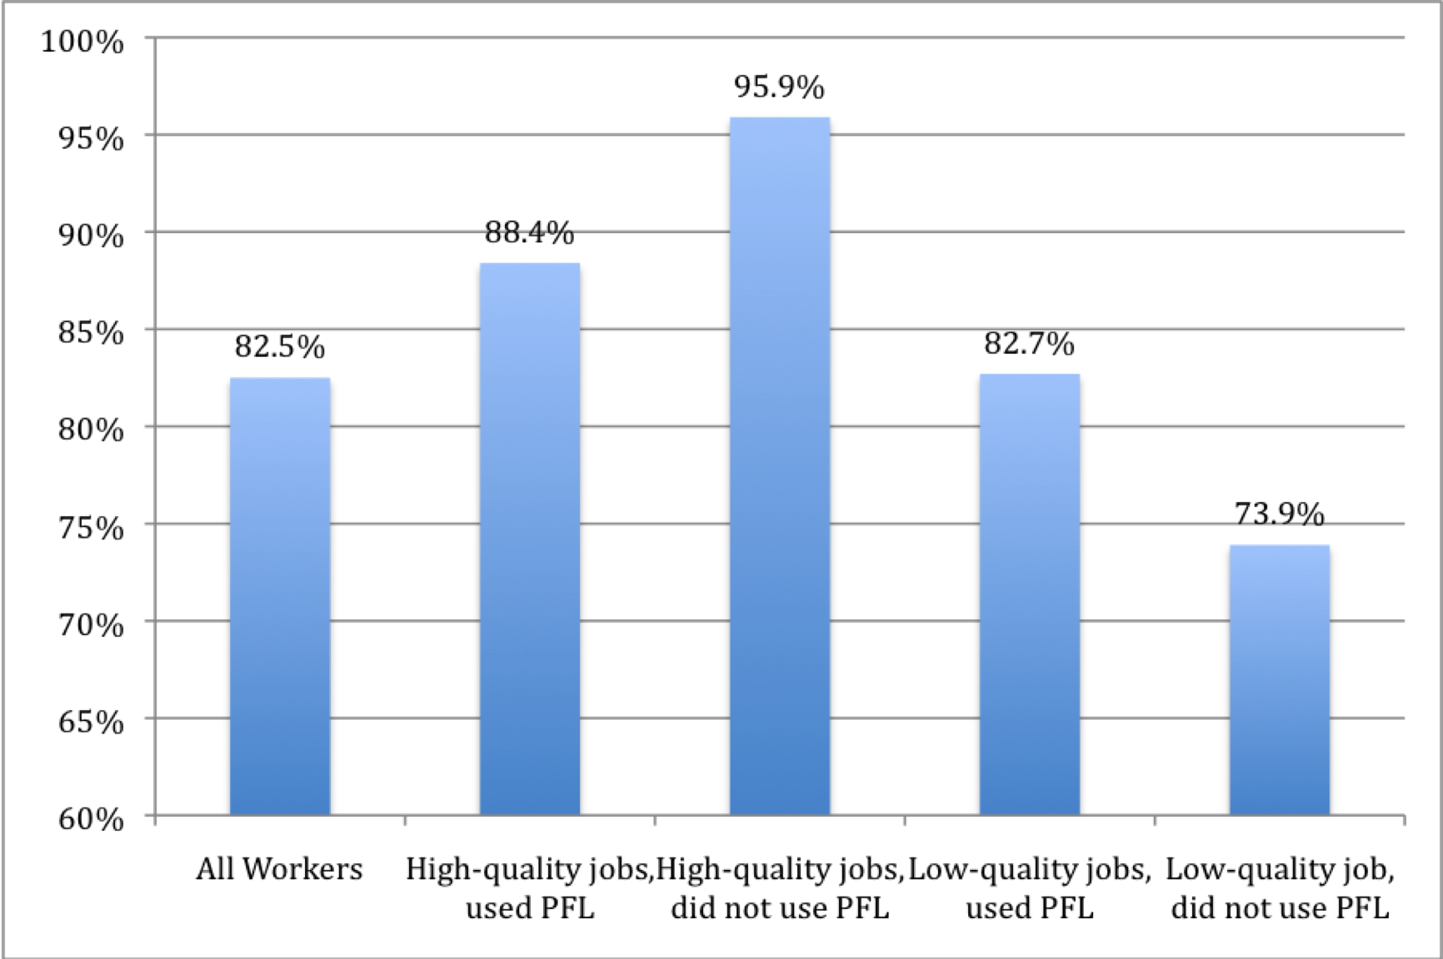
Percentage of Workers Who Returned to Former Employer after a Leave, by Job Quality and Use of PFL, 2009-10 (N=165)

Slide 20
FIELDWORK EVIDENCE ABOUT EFFECTS OF PFL ON TURNOVER
Site visits and interviews with managers at 20 businesses in CA and similar number in NJ
Discovered most managers, even corporate HR in large companies, do not routinely track costs of turnover
  Often fail to include all costs when they do calculate it
  E.g. a large retail clothing chain with 100% turnover – does not include cost of recruiters in turnover costs
Survey included set of questions from which we were able to calculate organization’s cost of turnover

Slide 21
TURNOVER COSTS (our sample)
 | NON-EXEMPT |  | EXEMPT
 | N | Average | N | Average
Firm size < 50 | 89 | $5,399 | 51 | $12,625
Firm size 50-499 | 58 | $4,149 | 49 | $13.912
Firm size 500+ | 51 | $7,987 | 48 | $18,331
Total | 198 | $5,332 | 148 | $12,887

Slide 22
TURNOVER COST CALCULATOR
How much does employee turnover cost your business?
Use This Turnover Calculator To Find Out
  http://www.cepr.net/calculators/turnover_calc.html
Turnover is costly, yet many businesses do not track how much it costs them. This turnover calculator provides an estimate of how much turnover costs your organization.
Costs often vary for different types of employees. The turnover calculator takes into account variation in wages, weekly hours, and recruiting and hiring costs to calculate the cost of turnover for various categories of workers.

Slide 23
OTHER EFFECTS OF FAMILY LEAVE ON EMPLOYERS ARE MODEST
At any given time, relatively few workers go on leave
  PFL only leads to a small increase in leave-taking
  Leave length only slightly longer with PFL, except for non-exempt women caring for ill family members
Most work of leave takers is assigned to co-workers, at little or no cost to employers
But few co-workers report negative effects

Slide 24
EMPLOYER-REPORTED PROPORTION OF
WORKERS ON LEAVE (in previous year)
 | Total |  | Firm Size < 50 |  | Firm Size 50-499 |  | Firm Size 500+
 | 2004 | 2010 | 2004 | 2010 | 2004 | 2010 | 2004 | 2010
Number of firms | 263 | 253 | 134 | 102 | 65 | 84 | 64 | 67
Parental (median) | 1.8% | 2.5% | 6.7% | 7.4% | 1.4% | 2.1% | 1.7% | 2.4%
Pregnancy (median) |  | 2.5% |  | 6.5% |  | 2.5% |  | 2.0%

Slide 25
MEDIAN LENGTH OF LEAVE - IN WEEKS (employee survey)
 | Baby Bonding |  | Ill Family Member
 | 2004 | 2010 | 2004 | 2010
# leave takers | 65 | 98 | 33 | 53
EXEMPT | weeks | weeks | weeks | weeks
Male | 3 | 3 | 3 | 4
Female | 11 | 12 | 4 | 4.5
NON-EXEMPT
Male | 3 | 3 | 3 | 3
Female | 12 | 12 | 3 | 5.5

Slide 26
HOW WORK OF EMPLOYEES ON LEAVE WAS COVERED (2010)
 | Exempt Workers |  |  |  | Non-Exempt Workers
 | Total | Firm Size <50 | Firm Size 50-499 | Firm Size 500+ | Total | Firm Size <50 | Firm Size 50-499 | Firm Size 500+
Assign Work to Others | 76.9% | 72.3% | 100% | 98.0% | 89.8% | 88.1% | 96.8% | 100%
Hire Temps | 39.3% | 39.9% | 36.8% | 27.5% | 48.7% | 52.4% | 32.3% | 46.2%
Hire Replacements | 0.4% | 0% | 0% | 3.9% | 2.4% | 0% | 12.9% | 1.9%
Put Work on Hold | 59.1% | 67.5% | 15.8% | 31.4% | 8.0% | 6.0% | 16.1% | 20.8%
Workers Do Some Work While on Leave | 45.5% | 52.0% | 13.2% | 5.9% | 6.6% | 6.0% | 9.7% | 1.9%
Some Other Method | 15.7% | 16.2% | 13.2% | 11.8% | 9.7% | 6.0% | 25.8% | 18.9%
* Totals may be greater than 100% because employers can report more than one method

Slide 27
WORKER-REPORTED IMPACTS OF CO-WORKER LEAVE
Worker-Reported Rates and Impacts of Co-Workers Taking Leave
 | Total
 | 2004 |  | 2009-10
A Co-Worker Has Taken Leave | 56.7% |  | 60.9%
Results of Co-Worker Leave
- More Hours | 32.5% |  | 33.0%
- Extra Shifts * | 22.7%
- More Duties | 52.6% |  | 51.2%
Impact of Co-Worker Taking Leave
- Positive | 16.1% |  | 24.7%
- Negative | 10.1% |  | 6.4%
- Neither Positive or Negative | 73.7% |  | 68.9%
* 2009 survey does not ask about extra shifts

Slide 28
FIELDWORK CONFIRMS SURVEY FINDINGS
Unexpected family leaves are inevitable, so all organizations have contingency plans
Most work covered by co-workers, though for some jobs this is impossible, and costs are incurred.
Leave policies improve retention and morale
PFL (like FMLA) is a“non-event” for most employers

Slide 29
FIELDWORK: Examples
A multitude of innovative practices are used to minimize impact on operations whenever an employee is absent for more than a few days
Examples
  IT company (< 50 employees)
  Large hospital
  Retail and farms
  Biotech company
  Large engineering/construction firm
  Small branch of restaurant chain

Slide 30
THREE MYTHS ABOUT PFL
It includes new mandates requiring employers to hold jobs for employees who take family leave
It raises employers’ costs and is a “job killer”
It will be widely abused by employees

Slide 31
NO NEW MANDATES
Since 1993, FMLA has required employers with > 50 employees in 75-mile radius to hold job (or similar job) for employee who takes up to 12 weeks of family or medical leave
PFL in CA and FLI in NJ are insurance programs. Unless an employee’s job is already protected by FMLA or specific state legislation, employer is not required to hold the employee’s job
Eligible employees are able to collect up to 6 weeks partial income through state PFL or FLI program

Slide 32
SAVINGS FOR SOME EMPLOYERS
87% of California employers reported no cost increases resulting from PFL
9% reported cost savings
60% reported that they coordinated their own benefits for exempt workers with PFL; 58% did so for non-exempts – suggests additional savings
13% reported extra costs (hiring, training expenses)

Slide 33
ALMOST NO EMPLOYEE ABUSE
After nearly six years of PFL in CA, employers in 2010 survey reported almost no employee abuse of program
91% reported no knowledge of PFL abuse among employees they are responsible for
Of the 9% who were aware of abuse, many reported only one instance
99.5% knew of no more than five instances
In short, employee abuse is rare

Slide 34
BUT SOME EMPLOYEES FEAR NEGATIVE REPERCUSSIONS FOR USING PFL
Over a third were concerned about employer retaliation
  31% feared their “employer would be unhappy”
  29% feared it would hurt their prospects for job advancement
  24% feared they would be fired
  In all, 37% were concerned about their employer’s response
Other reasons
  31% felt the PFL benefit level was too low
  18% thought it was too much hassle to apply
(N= 89; not a representative sample of employees; respondents could cite multiple reasons)

Slide 35
MODEST IMPACT ON EMPLOYERS, BUT LARGE BENEFITS FOR EMPLOYEES
Employees who used PFL had higher rates of wage replacement than those who did not – with especially strong effects for those in low-quality jobs
PFL users were able to take somewhat longer leaves, and were more satisfied with leave length, than those who did not use PFL for their leave
PFL users were more likely to return to work for the same employer than non-users
Care of new children/ill family members was enhanced by PFL use
(2009-10 California employee survey, n=500)

Slide 36
Wage Replacement and Job Quality
(High-quality job: over $20/Hr + health insurance)
Proportion of Usual Pay Received During Leave | High-Quality Jobs |  | Low-Quality Jobs
 | Used PFL | Did Not Use PFL | Used PFL | Did Not Use PFL
No Pay | 0.0% | 11.0%* | 0.0% | 38.2%***
Less Than Half | 0.0% | 12.4%** | 16.2% | 12.5%
About Half | 55.3% | 9.6%*** | 25.9% | 16.7%
More Than Half | 37.8% | 17.0% | 48.2% | 10.9%***
Full Pay | 6.9% | 50.0%*** | 9.7% | 21.6%
 | 100.0% | 100.0% | 100.0% | 100.0%

Slide 37
LIMITED AWARENESS
22% of California adults were aware of new law in fall 2003; 29.5% in summer 2005, 28.1% in summer 2007
Field Poll in summer 2011 found 44.9% of those who voted in 2008 were aware of PFL, compared to 29.7% in fall 2003 who had voted in 2000
Poor enforcement, limited outreach
Those who need the program most, are least likely to know about it.

Slide 38
Male Take-Up Has Grown

Slide 39
FUTURE PROSPECTS FOR PAID FAMILY LEAVE LEGISLATION
Paid family leave
  Passed in Washington in 2007, but recession hit before funding mechanism in place, so start has been delayed
  Other states where legislation is being actively pursued include: Arizona, Illinois, Maine, Massachusetts, Missouri, New Hampshire, New York, Oregon and Pennsylvania
  Obama administration has expressed commitment to advancing paid family and medical leave
  Obama’s 2010, 2011 and 2012 budgets included start-up funds for states that want paid family and medical leave
  (but funds were not included in final 2010-2011 budgets)

Slide 40
FUTURE PROSPECTS FOR PAID SICK DAYS LEGISLATION
Three cities currently have paid sick days legislation
  Washington, DC
  San Francisco
  Seattle
Similar legislation seems likely to pass in Philadelphia
One state – Connecticut – passed a paid sick days law

Slide 41
CONNECTICUT’S PAID SICK DAYS LEGISLATION
July 1, 2011 – Connecticut became first state to require employers to provide paid sick days to employees
Law went into effect on January 1, 2012
Enables service workers employed in businesses or other entities that employ fifty or more individuals in the state to accrue paid sick leave (of one hour of paid sick leave for each forty hours worked, up to a maximum of 40 hours in one year)
Paid sick days are earned by all employees including part-timers

Slide 42
SUMMING UP
Paid Family Leave and Paid Sick Days are very popular programs that are likely to be legislated in more states and cities, and perhaps eventually at the national level
The experience thus far in California suggests that fears that these programs would prove burdensome to business were mostly unfounded
Costs have been minimal, and for many employers these programs bring cost savings
Abuse has been minimal as well
Overall, a “non-event” for most employers

