Slide 1
Private Equity in the US: Impacts on firms and workers
Eileen Appelbaum and Rose Batt
Russell Sage Foundation
April 4, 2012

Slide 2
OUTLINE
From Managerial to Financial Capitalism
PE Model
Private Equity and Firms
Sources of PE Returns
Impact on Management and Employment
PE and Risk of Bankruptcy
PE and Returns to Investors
Conclusions

Slide 3
Shift from Managerial to Financial Capitalism
Managerial capitalism – returns on investment derive from value created via production or trading of goods or services
Financialization – refers to new form of “financial capitalism” that emerged in 1970s, companies viewed as
Assets to be bought and sold
Vehicles for maximizing profits through financial strategies
Buying/selling companies or divisions of companies, selling off assets, excessive use of debt, share price manipulation
Investors make profits without regard to effects on productivity, quality, innovation, employment, or long-term competitiveness
Change has implications for management & labor outcomes

Slide 4
Process of Financialization Underway
Sharp increase beginning in the 1980s in
Dominance of financial sector in economy as a whole
Financial sector has captured growing share of corporate profits, cash flow after 1980s (Palley 2007, Watt and Galgoczi 2009, Krippner 2011)
Growing importance of financial activities in non-financial firms (Krippner 2011)
Revenue from financial as compared to productive activities (dividends, capital gains, interest payments to corporate cash flow)
Stable in 1950s, 1960s - less than 10%; rose in 1980s, stabilized in 2000 at about 40%

Slide 5
Interaction between Actors in Real Economy
Financialization => external financial actors influence or control organizational strategies, financial outcomes of non-financial firms
Assumes capital is highly mobile – can be moved around to buy or sell firms (Lazonick 2009)
Firms not locked into fixed capital investments, make them work
Jack Welch at GE – exit product markets you don’t like
Share price underperforms – firm is takeover target
Leads to focus on stock price rather than R&D, innovation
Capital relatively liquid => employees disposable
Success due more to financial activities, less incentive to invest in worker skills and retention

Slide 6
Managerial Capitalism
Separation of ownership and control supported by New Deal securities law that limited speculation
Separation criticized by Berle & Means, Jensen et al.
But, it enabled managers to allocate capital, use retained earnings to invest in technology, machinery, worker skills, R&D
Management goal: develop new products/processes, expand and increase market share
Provided managers with opportunities for promotion, income growth, status, long organizational careers
Shareholders benefited from a steady stream of dividends, workers from rising wages
Created large-scale production, mass distribution to growing middle class

Slide 7
Managerial Capitalism
Managerial business model not ideal
Opportunistic managers
Labor-management conflict
Wage gains hard fought
But employers largely abided by labor laws
Unions able to negotiate contracts that linked wage growth to productivity gains (Kochan, Katz, and McKersie 1986; Lazonick 1992, Davis 2009)
Basic services (banks, telecomm, health, education) regulated and widely distributed

Slide 8
Institutional Changes
1950 Celler-Kefauver Act – anti-trust law
Limited horizontal mergers, vertical integration
Led to conglomerate mergers and managing by numbers
Justified by portfolio theory
Frequent buying/selling firms – viewed as financial assets
Undermined ability of managers to make strategic decisions
Managerial opportunism easier, poor financial performance
Increased power of CFO, CEO viewed as feathering own nest
What should be done with free cash flow? Struggle over retained earnings

Slide 9
Regulatory Changes
Supreme Court overturned state anti-takeover laws, corporate raiders – more opportunities (Jarrell 1983)
Federal Trade Comm. made horizontal mergers easier
ERISA acts 1974, 1978: let pensions make risky investments
Garn-St. Germain Act of 1982 allowed S&Ls to make business loans – opened door to junk bonds, S&L crisis
Freed up pools of private capital, increased role of institutional investors
Public markets: TYCO, ENRON, WorldCom, Global Crossing
Private markets: LBOs (private equity)

Slide 10
Intellectual Rationale: Agency Theory
Critique of managerial capitalism
Managers fail to maximize shareholders profits
Managerial autonomy: “Inefficient behaviors”
Firms should return free cash flow to shareholders
Provides rationale for leveraged buyouts (1980s)
Concentrated ownership: More shareholder control
Debt disciplines managers
Need to borrow to invest, market test of investment decisions
Limits opportunities for managerial opportunism
Profits, high free cash flow, for shareholders
Notes:
Debt disciplines managers – less room to negotiate with other stakeholders
First round of leveraged buyouts ended in financial crisis and scandal, but the views of agency theorists continued to prevail and new approaches to increasing and capturing shareholder value have emerged. Companies use free cash flow to buy back their own shares and distribute profits to shareholders

Slide 11
Emergence of Private Equity
KKR was leading architect of LBO model in 80s
KKR buyout of Houdaille in 1979 launched model of financial engineering that became dominant
Fortune 500 company, 7,700 employees, lots of cash on hand, little debt, undervalued stock
Complex financial deal, used very little of KKR’s own capital, loaded debt on Houdaille
Debt critical to financial gains: magnified returns; disciplined managers; serviced with retained earnings and tax savings
Use of junk bonds, high debt => rash of bankruptcies
Decade ended in scandal, but LBOs reinvented as PE, re-emerged in late 1990s, expanded in 2000s

Slide 12
Scale of PE Activity
Wharton Private Equity 2011:
PE buyout funds have capital of about $1.3 trillion globally
With leverage, investment portfolio is 3 or 4 times as large
Private Equity Growth Capital Council 2011:
2,300 PE firms headquartered in US
8.1 million employees on payrolls of PE-backed companies
Pitchbook data (January 2012):
16,320 PE-backed companies headquartered in the US
6,986 US companies are currently private equity-owned.

Slide 13
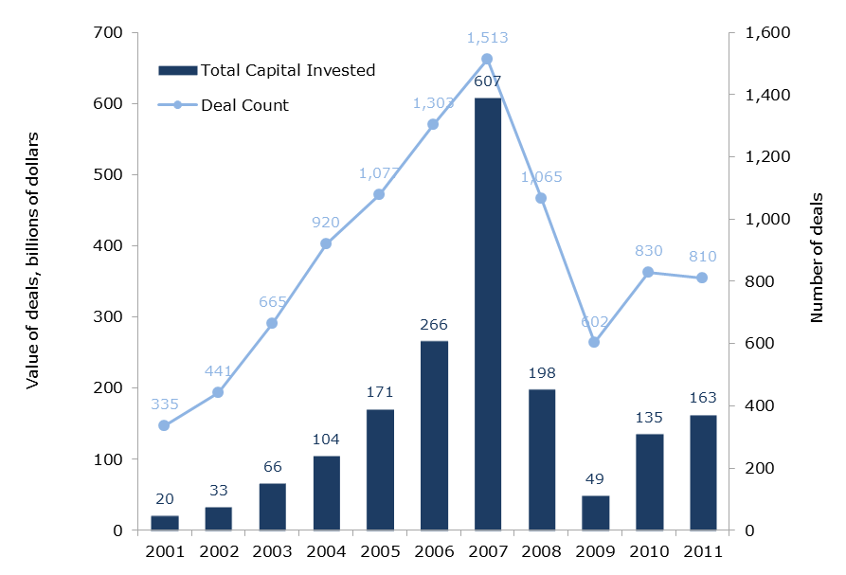
Growth of Private Equity
Annual PE Capital Invested and Deal Count: 2001-2011
Source: Pitchbook Data

Slide 14
Private Equity Business Model
Investment fund
Sponsored and managed by PE general partners (2% of fund)
Investors are limited partners (Pension funds, etc.) (98%)
PE general partners earn ‘2 and 20’
Traditionally, 2% management fee (ordinary income)
20% of profits (carried Interest) after hurdle rate of 8%
Limited partners (Investors)
Must keep funds available for 10 years
Promised higher than normal returns

Slide 15
Private Equity Business Model
PE firm buys companies using high leverage (75%)
Uses assets of portfolio company as collateral, portfolio company responsible for paying back debt
Typically takes public companies private (no disclosure)
Actively manages portfolio company => constrains managers’ decision making
Attempts to exit in 3-5 years
If deal goes badly, neither PE firm nor PE fund liable for loss
Notes:
Pe firm makes all decisions about which firms to purchase, how to manage, how to exit
LPs commit funds for given period (10 years) even if the PE firm does not use them
They share in gains or losses but have no say
Cannot withdraw funds during that period
Each fund separate; investors may lose equity, creditors can seize property, PE fun not liable

Slide 16
Private Equity and Labor Relations
Some PE owners negotiate with unions (TXU case)
PE negotiates with union, environmental groups
2007 $40B buyout by PE
2011: Still saddled with $20 billion in debt
2011: Analysts estimate 91% chance of default in next 3 years
Union marginalization: (US FoodService)
Unions not informed of PE purchase
PE refuses to negotiate; marginalizes union
Anti-union campaign – 200 labor law violations
Managers don’t have authority to negotiate
Notes:
Management-union relations were cooperative under Ahold, but the new owners refused to consider the union’s offer to partner on productivity improvements. Instead, they pursued a campaign of cost-cutting and work intensification; started shifting work to non-union worksites; and launched an anti-union campaign against one organizing drive that led the National Labor Relations Board to cite the company for 200 violations of the law

Slide 17
Sources of Gains to PE Investors
Primary goal: Maximize returns
Overall returns to fund investors over a few years
Not long-term competitiveness of any individual company
Sources of gains
Operations engineering
Stock market gains
Management fees
Financial engineering
Asset stripping, tax arbitrage, high leverage, dividend recaps
Breach of trust (Schleifer and Summers 1988)
Bankruptcy for profit (Ackerlof and Romer 1993)
Notes:
). First, there may be genuine improvements in performance arising from better management, new strategies, and improvements in methods of value creation. Second, there may be value transfers from government and taxpayers arising from financial engineering - the use of debt limiting corporation tax, lower capital gains replacing higher income tax, and the transfer of profits abroad. Third, there may be transfers from other capitalists i.e. acquiring good companies at low prices and selling them at inflated prices. Furthermore value transfers from debtholders may also take place as the probability of bankruptcy typically increases with increasing leverage and the value of existing debt decreases. Finally, there may be value transfers from employees first to the company and later to the investors

Slide 18
Sources of Gains to PE Investors
Operations engineering: Increase profit margins
Raise revenues: Improvements, acquisitions
PE can raise finance for investment, provide management know-how
Not many companies have adopted HPWS => room for improvement
“Secret sauce”
Reduce labor cost ratios: Better use of tech/work organization
Or downsizing, intensification of work, deferred maintenance, etc.
Stock market: Increase multiple at which company sold
Due to real or ‘squeezed’ performance improvements
Or a bull market in stocks may raise multiples for all companies

Slide 19
Management Fees and Investor Returns (Metrick & Yasuda 2009)
Traditionally, PE firm collects 2% on all committed capital*
Annual charge is 2% first 5 years, may decrease after
PE raises $100 Million Fund – 10 years
2M/year * 10 years = $20M
$80 M left for investment
Has incentive to raise larger funds; subsequent funds are larger
2/3 of GP income comes from management fees
Revenue per $ of committed funds decreases as funds grow in size, but larger funds => higher management fees and earnings for GP
*Plus transaction fee (buying/selling), fee for monitoring portfolio firm – collected from portfolio firm, shared with LPs; plus ‘establishment fee’ of up to $1 million from LPs

Slide 20
Financial engineering: Leverage/Taxes
Buy a $100M company with $100M in cash
Sell the company for $120 M in cash after one year
$120 - $100 = $20 ; ($20/$100)* 100 = 20% (ROI)
Buy $100M company, $50M cash and $50M debt @ 10% interest
Make interest payment of $5M, Tax saving of .35* $5 = $1.75M
Sell company for $120M in cash after one year; repay $50M loan
$120 - $(5 – 1.75) - $50 - $50 = $16.75
($16.75/$50)*100 = 33.5% ROI
Buy a $100 M company, $25M cash and $75 debt @ 10% interest
Make interest payment of $7.5M; tax saving of .35*$7.5 = $2.63M
Sell the company for $120M in cash after one year; repay $75M loan
$120 - $(7.50 – 2.63) - $25 - $75 = $15.13
($15.13/$25)*100 = 60.5% ROI (without tax saving, ROI = 50%)
Notes:
). First, there may be genuine improvements in performance arising from better management, new strategies, and improvements in methods of value creation. Second, there may be value transfers from government and taxpayers arising from financial engineering - the use of debt limiting corporation tax, lower capital gains replacing higher income tax, and the transfer of profits abroad. Third, there may be transfers from other capitalists i.e. acquiring good companies at low prices and selling them at inflated prices. Furthermore value transfers from debtholders may also take place as the probability of bankruptcy typically increases with increasing leverage and the value of existing debt decreases. Finally, there may be value transfers from employees first to the company and later to the investors

Slide 21
Financial Engineering: Dividend Recapitalization
PE firm takes out additional loan to pay self and investors dividends – often high risk junk bonds
Undermines argument that PE returns due to improvements in firm performance and high exit price
Harry & David recouped its equity in first year, via dividend recap
Some PE firms accused by creditors of ‘bleeding-out’ company, causing it to become insolvent
Sun Capital faces such an accusation in relation to Mervyn’s
Apax Partners and TPG Capital face similar with TIM Hellas
Some PE investors concerned won’t recoup investment
Urban Brands (Ashley Stewart & Marianne stores)
Hospital Corporation of America (HCA)

Slide 22
Dividend Recapitalization: HCA
PE (Bain &consortium) acquired HCA in 2006 for $21B
PE put in $4.5B of its own funds; borrowed 80% of cost
Anticipated returns were limited due to the recession
2010: PE partners issued $4.25B in junk bonds to pay themselves ‘dividend recapitalizations’ in 3 tranches
2011: PE partners took HCA public for an additional $3.8B
Post-IPO, HCA has $26 billion debt ($12B more than its assets)
Notes:
HCA (Largest for profit chain in US: 190,000 employees)

Slide 23
Breach of Trust
Breaching implicit contracts with stakeholders may increase shareholder returns at expense of stability and long-term competitiveness of firm
May default on implicit contracts managers had established prior to buyout (e.g., workers, vendors)
Examples
Mervyn’s – vendors
EMI – talent pipeline/knowledge workers
Stuyvesant Town/Peter Cooper Village – renters
Cadbury’s – community
Antitrust suit – shareholders in publicly-traded firms

Slide 24
Breach of Trust: Mervyn’s Retail
Leveraged buyout 2004: $1.2B (debt load = 80%)
Operational Improvements (Some investments; store closings)
Asset Stripping: “Op-Co, Prop-Co”
Mervyn’s charged inflated rent on buildings it used to own
Dividend Recapitalization: PE paid itself $400M
Breach of Trust: Employees, vendors
Bankruptcy 2008: Mervyns lost $64M; paid $80M in rent
Vendors suing owners
Notes:
PE consortium: Sun Capital Partners, Cerberus Capital Management, and Lubert-Adler and Klaff Partners in 2004 for $1.2 billion.
Operations: Improved by closing unprofitable stores & increasing product offerings
Mervyns (Chain of over 250 stores)

Slide 25
Bankruptcy for Profit?
“…only a small minority of pre-default [PE] owners retains control of companies”
(Hotchkiss, Smith & Strömberg. PE and Resolution of Financial Distress, 2011:4)
Sun Capital Portfolio Company Bankruptcies
Friendly’s Ice Cream LBO 2008
Fluid Routing Systems LBO May 2007
Big 10 Tire LBO Nov 2006
Anchor Blue – LBO Nov. 2003

Slide 26
Private Equity and Jobs Davis et al. 2008 vs. Davis et al. 2011
Compare employment dynamics in “targets” acquired by PE in LBO 1/1980 – 12/2005 with “controls”
Same data sets and methodology used in both, but
Results in 2008 far less favorable to PE
But even in 2011, no support: “employment grows a tad more slowly in PE than in non-PE owned companies”
Hint: Acquiring a company and its employees does not count as job creation

Slide 27
PE and Jobs: Results from 2008 Study
Establishments
“…five years after the transaction, the targets have a level of employment that is 10.3% lower than it would be if targets had exhibited the same growth rates as controls” (p. 50)
Firms - restricted sample b/c matching issue, firm deaths
Jobs analysis includes greenfield sites, acquisitions, divestitures
Two years after transaction: “targets have a 3.6% lower net employment growth rate than controls over this period” (p. 52)
Target firms shut down twice as many establishments than controls

Slide 28
PE and Jobs: Results from 2011 Study
Establishments
“Perhaps surprisingly, …[there is] no systematic pattern of slower job growth at targets in the years leading up to buyout transactions. In the transaction year itself, employment growth at targets is actually 2 percentage points higher than at controls. However, there is a clear pattern of slower growth at targets post buyout, with growth differentials ranging from 0.5% to 2% per year. These differentials cumulate to 3.2% of employment in the first two years post buyout and 6.4% over five years.” p. 17
Distressed investing only 1-2% of LBOs 1990-2007 (Kaplan & Strömberg 2008:8)
“Slower employment growth at PE targets post buyout entirely reflects a greater pace of job destruction” pp. 17-18; half due to closings
In retail, employment falls by nearly 12% in targets relative to controls

Slide 29
PE and Jobs: Results from 2011 Study
Firms
Continuers and deaths: “Summing these two components yields a two-year employment growth rate differential of -5.49 percentage points (-1.36 -4.13) for targets, a large difference” p. 23
Adding in greater job growth for targets than controls at greenfield establishments (+1.87)” yields a differential of -3.62 percentage points for targets” p. 23
Only when acquisitions are included does the employment growth differential shrink to less than 1%
“Finally, bringing in the role of acquisitions and divestitures reduces this differential to -0.81 points …” p. 23

Slide 30
Why So Much Job Destruction in Retail?
Competitive pressure on retailers ?
Wal-Mart, Target, Sam’s Club and Amazon and others
Applies equally to retailers that are PE targets and other retailers
OpCo/PropCo model in retail (other w/large RE assets)
Retail highly cyclical: traditionally low debt, own store properties
PE splits retail chain into operating company that runs the stores, property company that owns the real estate, sells to REIT
OpCo pays rent to PropCo
W/O cushion and w/high rent, any trouble = distress

Slide 31
Risk of Bankruptcy Strömberg 2008 vs. Hotchkiss, Smith & Strömberg 2011
“Proponents have identified benefits of LBOs … Relatively less attention has been given to the potential downside of these transactions, namely that their high debt levels greatly increase the risk of financial distress” HH&S, p. 2
2008: Compares PE and publicly traded firms
PE-owned companies have substantially higher levels of debt
For LBOs completed between 1970 and 2002
7% became bankrupt while in PE hands
Study ends before severe recession & financial crisis late 2000s
Twice annual bankruptcy rate of publicly traded: 1.2% vs. 0.6%

Slide 32
Risk of Bankruptcy (2011)
Compares highly leveraged PE firms with other highly leveraged firms (spillover: Booz-Allen-Hamilton; YRC)
2,156 firms, half PE-owned, Jan 1997-Apr 2010
No surprise - both have high default rates
5.1% for PE-backed firms vs. 3.4% for non PE-backed
In period since financial crisis, default rate for highly leveraged firms increased to 25%
PE sponsors help facilitate restructurings
Nevertheless, recovery rates to creditors are lower when company is PE-backed – to bond holders, not banks
Notes:
Bondholders recover less in PE-backed bankruptcies because PE firms better able to negotiate ‘covenant lite’ agreements, so lenders have little early recourse.

Slide 33
Measuring Fund Returns (Kaplan and Schoar 2005) vs.(Harris, Jenkinson and Kaplan 2011)
Venture Economics data (2005) from reporting by GPs & LPs
“[w]e believe that if there is a bias it would most likely take the form of underreporting by worse performing funds. ….this would create an upward bias on our results on average returns.” p. 1794
VE data (2011)
“VE PMEs are lower than those of the other three commercial databases….We interpret our results as suggesting that it is highly likely that the VE returns understate buyout fund performance.” pp. 3-4
Burgiss data (2011) from LPs that use Burgiss system
Unknowable (self) selection bias in both data sets

Slide 34
Method to Compare PE Returns to S&P: 2005 vs. 2011
Public Market Equivalent (PME) compares LP return net of fees to equivalent investment in S&P 500
Private Equity Returns (2005)
Sample includes only funds that are liquidated
Inflows are actual cash flows to LPs, not subjective estimates
Private Equity Returns (2011)
Sample includes funds that have not exited all investments
Distributions include estimated value of unrealized (illiquid) investments in portfolio companies
55% for median 2002 fund, 71% for median 2003 fund, exceed 80% for vintages after 2003

Slide 35
LP Returns Net of Fees Relative to S&P 500
Kaplan & Schoar 2005: Vintage 1984-1997
On average, investing in S&P 500 beats PE
Only top quarter of PE funds beats market on average
Equal weighted: Median = 0.80, Av = 0.97, 25%ile = 0.63, 75%ile = 1.12
Size weighted: Median = 0.83, Av = 0.93, 25%ile = 0.72, 75%ile = 1.03
Harris, Jenkinson & Kaplan 2011: Vintage 1984-2008
On average, PE beats investing in S&P 500
Includes estimates of returns for companies still in portfolio
Equal weighted: Median = 1.16, Average = 1.22
Size weighted: Average = 1.27

Slide 36
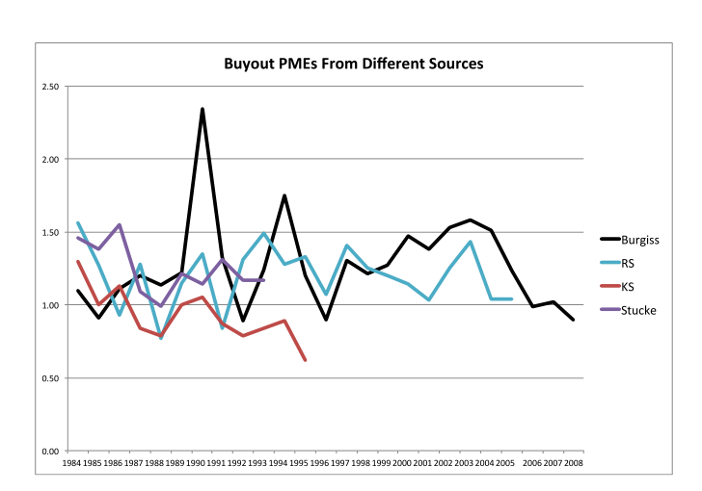
Returns to PE/Returns to S&P 500 (Public Market Equivalent)
Harris, Jenkinson and Kaplan 2011

Slide 37
Conclusions
PE business model challenges existing theories:
HR, OB, labor relations
Employment relations scholars already pay attention to how IR, technology, markets shape/constrain management
Need to pay attention to ways financial institutions also have influenced the relationship between management and labor
Incentive structure of funds: Perverse consequences?
Tax reform to address
PE-owned firms:
Less managerial control
More job destruction
Higher default and bankruptcy rates
PE and Investor Returns (Break-even)

